Slide 1

Facial Feature Detection
Presented by Muhammad Ali

Slide 2
Dataset Acquisition
Diverse & Balanced Data Collection
Curated a specialized dataset to train and evaluate facial feature detection model.
Collected 1750 images, ensuring a balanced representation across different demographics.
7 distinct races, with 250 images per race.
Each race partition was further balanced with 125 male and 125 female subjects.

Slide 3

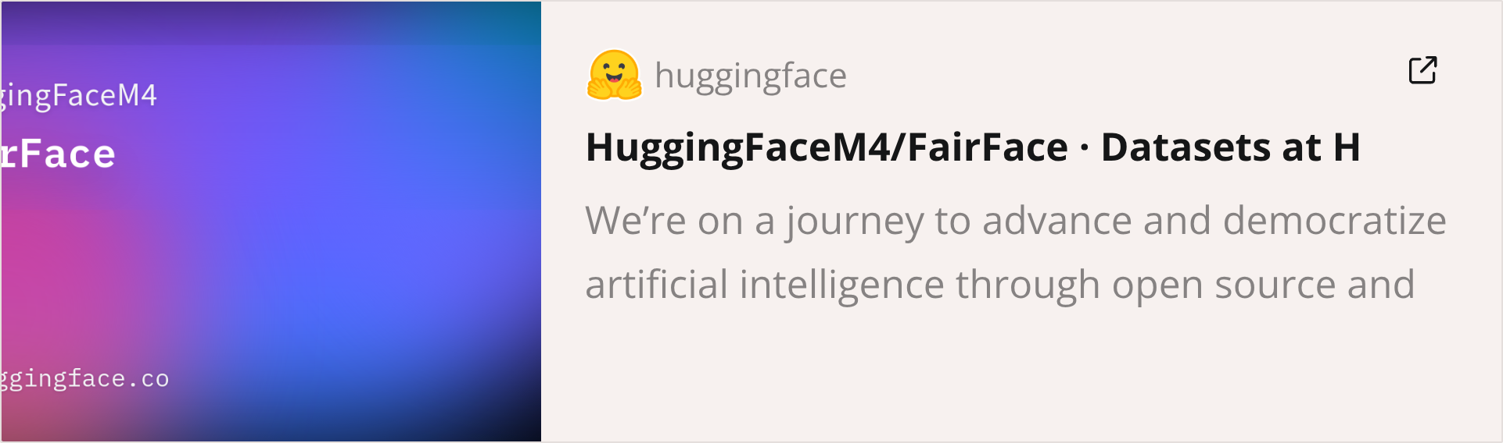
Dataset Sourcing
Leveraging the FairFace Dataset
The foundational dataset for facial feature detection was sourced from the FairFace dataset.
It is a comprehensive collection designed for fairness in facial attribute recognition by providing images from diverse races and 50/50 gender spilt.

Slide 4



Model Architecture
Single Multi-Task ResNet-18
For simultaneous prediction of gender, eyeglasses, and shirt color, a single ResNet-18 model employed.
Integrated Predictions
18 Layers Deep
Optimized for Speed
A unified model handles all three classification tasks, optimizing for efficiency and shared feature learning.
ResNet-18's 18-layer architecture provides sufficient complexity for accurate feature extraction without excessive computational cost.
Chosen for its balance of performance and inference speed, crucial for real-time applications.

Slide 5
Model Rationale
Why ResNet-18?
ResNet-18 was selected for its proven efficacy as a backbone in various computer vision tasks, particularly those involving facial analysis.
Efficiency: Its relatively shallow architecture, compared to deeper ResNet variants, ensures faster training and inference times.
Robustness: Known for its strong feature extraction capabilities and ability to generalize well, even with complex datasets.
Pre-trained Weights: Availability of pre-trained weights on large datasets like ImageNet significantly accelerates convergence and improves performance.
Deployment Feasibility: Its compact size makes it suitable for deployment in resource-constrained environments or edge devices.

Slide 6
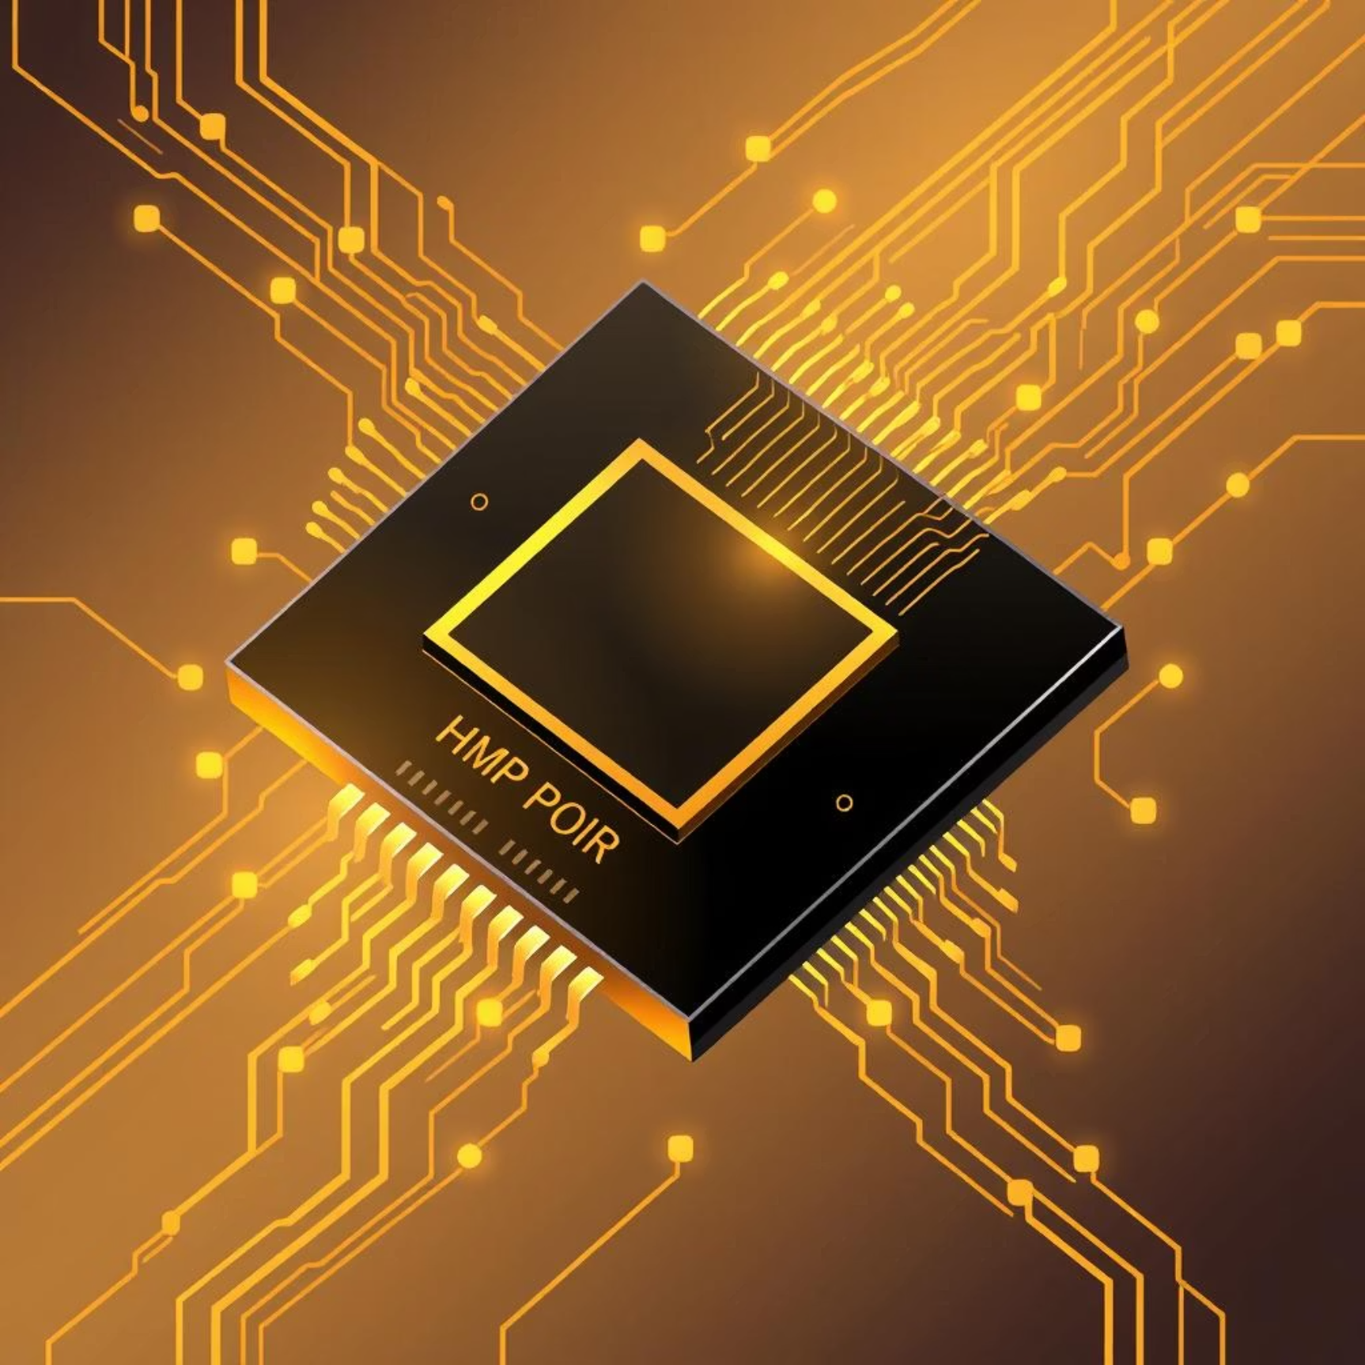
Alternative Model
Considering MobileNetV2
For scenarios prioritizing extreme computational efficiency and deployment on mobile or embedded devices, MobileNetV2 presents a compelling alternative.
Lightweight Architecture: Utilizes depthwise separable convolutions to significantly reduce computational cost and model size.
Inverted Residuals: Its unique inverted residual and linear bottleneck layers enhance efficiency while maintaining accuracy.
Edge Device Optimization: Specifically designed for high-performance inference on devices with limited processing power and memory.

Slide 7
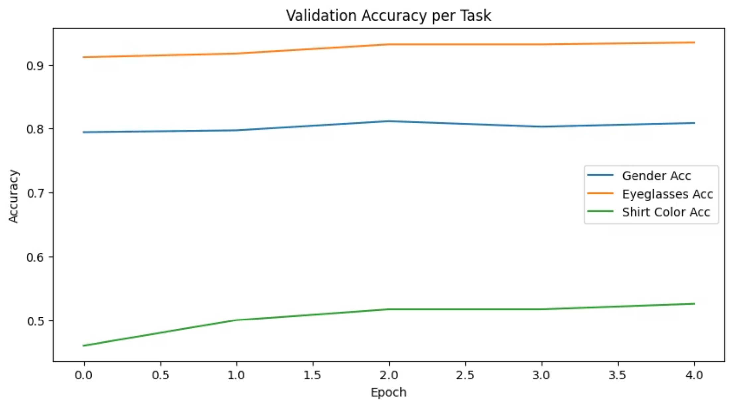
Performance Metrics
Accuracy Per task
Gender: 80.9%
Eyeglasses: 93.4%
Shirt Color: 52.6%
(Shirt color accuracy is low because of 11 output colors, more data will increase accuracy)(Increasing epochs might also accuracy)

Slide 8
Performance Metrics
Real-time Detection Capability
ResNet-18 model demonstrates efficient inference, crucial for applications requiring rapid processing of visual data.
0.05-0.1
Seconds per image
Average detection time on GPU, enabling near real-time performance.
This speed allows for seamless integration into various real-world applications, from security systems to interactive user interfaces.

Slide 9
Challenges & Future Work
Overcoming Dataset Limitations
The primary challenge stemmed from dataset annotation, highlighting areas for future improvements.
Manual Annotation Burden
Limited Shirt Color Variance
The FairFace dataset lacked specific labels for eyeglasses and shirt color, necessitating extensive manual annotation. This was the most time-consuming phase of the project.
The collected images exhibited limited diversity in shirt colors, potentially impacting the model's generalization for this attribute. Future datasets should prioritize broader color ranges.

Slide 10




Thank you!

